Slide 1

NYRC
(Not Your Regular Cover)
TEAM NO. | 13
TEAM MEMBER | ROLL NO.
Honey Bansal | 2210990416
Ishan Sharma | 2210990420
Ishpreet Singh | 2210990425
Jai Chopra | 2210990427

Slide 2
Index
Introduction
Objective
Methodology, Approach & Techniques
Flow Chart
Result
Source Code (screenshots)
Future Scope
Conclusion
Reference

Slide 3
Introduction
Welcome to NYRC - Your Ultimate Destination for Stylish and Protective Phone Cases!
Are you looking to give your phone a makeover that reflects your unique style while ensuring its safety and durability? Look no further!
At NYRC, we're passionate about offering an extensive range of premium phone cases that not only elevate the aesthetics of your device but also provide maximum protection against daily wear and tear. Explore Our Exclusive Collection: With our curated selection of phone cases, you'll find designs that cater to every taste and preference. Whether you're into sleek and minimalist styles, vibrant and bold patterns, or even personalized cases to make a statement, we've got you covered. From trendy designs inspired by the latest fashion trends to timeless classics, our diverse collection ensures there's something for everyone.

Slide 4
Objectives
1.User-Centric Design:
Employ a user-centric approach to website design, ensuring intuitive navigation and a seamless shopping experience for customers browsing phone covers, desk mats, and hoodies.
Conduct user research to understand customer preferences, including design aesthetics, material preferences, and sizing requirements, informing the selection and presentation of products on the website.
2.Product Curation and Selection:
Curate a carefully selected range of phone covers, desk mats, and hoodies from reputable suppliers and manufacturers, focusing on quality, durability, and style.
Regularly update the product catalog to introduce new designs, trends, and seasonal offerings, keeping the selection fresh and appealing to customers.

Slide 5
Contd.
3. Customization and Personalization:
Implement customization options for phone covers and hoodies, allowing customers to personalize their purchases with custom designs, monograms, or text.
Utilize advanced printing techniques and high-quality materials to ensure custom designs are accurately reproduced and meet customer expectations.
4. Digital Marketing Strategies:
Develop targeted digital marketing campaigns across social media platforms, search engines, and email newsletters to promote new arrivals, special offers, and seasonal discounts.
Utilize social media advertising to showcase product features, customer testimonials, and user-generated content, engaging with customers and driving traffic to the website.

Slide 6
Contd.
5. Customer Engagement and Support:
Offer multiple channels for customer support, including live chat, email, and social media messaging, to provide prompt assistance and address any inquiries or concerns.
Implement a user-friendly returns and exchange policy to enhance customer satisfaction and confidence in their purchases.
6. Continuous Improvement and Optimization:
Monitor website analytics and performance metrics to identify areas for improvement, such as page load times, bounce rates, and conversion funnels.
Conduct A/B testing and usability testing to optimize website layout, product placement, and checkout flow, maximizing conversion rates and customer retention.

Slide 7
Contd.
7. Partnerships and Collaborations:
Forge partnerships with complementary brands, influencers, and bloggers in the fashion and lifestyle niche to showcase products and reach new audiences.
Collaborate with local artists and designers to create exclusive collections of phone covers, desk mats, and hoodies.

Slide 8
Methodology & Approach
Methodology: NYRC (NOT YOUR REGULAR COVER) embraces a modular and iterative development approach, placing emphasis on the incremental enhancement of features. The process commences with a meticulous analysis of user requirements, incorporating feedback and upholding stringent product quality standards. Subsequently, enhancements are implemented in phased iterations. Rigorous testing and iterative user feedback loops are integrated to facilitate continuous refinement.
Approach: The developmental ethos of NYRC revolves around meticulously sculpting a responsive and user-centric interface. By harnessing the robust capabilities of REACT JS for foundational robustness, CSS for meticulous aesthetic refinement, and JavaScript for imbuing interactive elements, the platform ardently champions a seamless and visually enthralling user experience. Embracing a mobile-first design paradigm, it ardently ensures optimal accessibility across a myriad of devices..

Slide 9
Techniques
React.js (JavaScript Library for User Interfaces): As the cornerstone of NYRC's architectural blueprint, React.js meticulously orchestrates the organization and presentation of content, elevating the platform's user experience to unprecedented heights. Through its dynamic component-based approach, React.js seamlessly integrates various elements, fostering an intuitive and immersive interaction paradigm. By meticulously sculpting each component, React.js ensures clarity and coherence, empowering users to effortlessly engage with and traverse the platform's rich tapestry of offerings.
CSS (Cascading Style Sheets): With CSS, NYRC undergoes a visual transformation, captivating users with its polished and refined appearance. Through skillful styling, CSS breathes life into the platform, harmonizing elements with elegance and sophistication. Beyond aesthetics, CSS enables NYRC to adapt seamlessly to diverse screen sizes, delivering a consistently exceptional experience across devices.

Slide 10
Contd.
JavaScript: The strategic integration of JavaScript introduces dynamic interactivity to NYRC, elevating user engagement to new heights. From real-time content updates to seamless form validation, JavaScript enhances functionality while maintaining responsiveness. By leveraging asynchronous operations, JavaScript ensures swift and efficient performance, enriching the overall user journey on NYRC.
By intricately weaving together these cutting-edge technologies, NYRC masterfully orchestrates a symphony of structure, elegance, and dynamism, culminating in an immersive user journey replete with top-tier phone covers, hoodies, and desk mats, tailored to the discerning tastes of our clientele, including bespoke customization options.

Slide 11
FLOW CHART
Enter website
Go to product list page
Search for items
Review recommended item
Use the menu button and navigate to the category
YES
Identify item for purchase
KEY
Action
Exit website
Add item to shopping cart
Decision
More items?
Checkout process
Login/signup page
Review order confirmation

Slide 12
Result
The flawless execution of the NYRC project culminates in a meticulously crafted assortment of user-centric, streamlined, and visually captivating phone covers, hoodies, and desk mats. Offering an expansive repertoire of over 100 meticulously curated options, including bespoke customization features, NYRC ensures an unparalleled shopping experience for its discerning clientele.
Key outcomes include:
Elevated User Experience:
Intuitive Interface: NYRC offers a seamlessly navigable platform, ensuring users can effortlessly browse through its offerings of phone covers, hoodies, and desk mats.
Visually Captivating Showcase: The platform presents an aesthetically pleasing display of products, captivating users with visually striking imagery and layouts.

Slide 13
Contd.
Expansive Product Portfolio:
Diverse Selection: NYRC boasts a meticulously curated assortment of over 100 phone covers, hoodies, and desk mats, catering to diverse tastes and preferences.
Customization Options: NYRC provides customers with the ability to personalize their purchases, offering bespoke designs tailored to individual styles.
Streamlined Interface:
Structural Integrity: Through seamless integration of HTML, CSS, and JavaScript, NYRC achieves a robust interface that ensures smooth navigation and seamless functionality.
Aesthetic Appeal: The platform's design elements, including layout, color schemes, and typography, are meticulously crafted to create a visually pleasing environment for users.

Slide 14
Contd.
Customer Delight:
Responsive to Feedback: NYRC actively solicits and incorporates customer feedback to continuously refine its offerings and enhance the shopping experience.
Enduring Relationships: By delivering exceptional service and products, NYRC cultivates strong relationships with customers, fostering high levels of satisfaction and loyalty.
Competitive Edge:
Product Excellence: NYRC's unwavering commitment to product quality, variety, and innovation positions it as a frontrunner in the digital retail landscape, setting it apart from competitors.
Industry Benchmark: NYRC establishes new benchmarks for distinction and excellence within the industry, serving as a beacon of inspiration for other retailers.

Slide 15
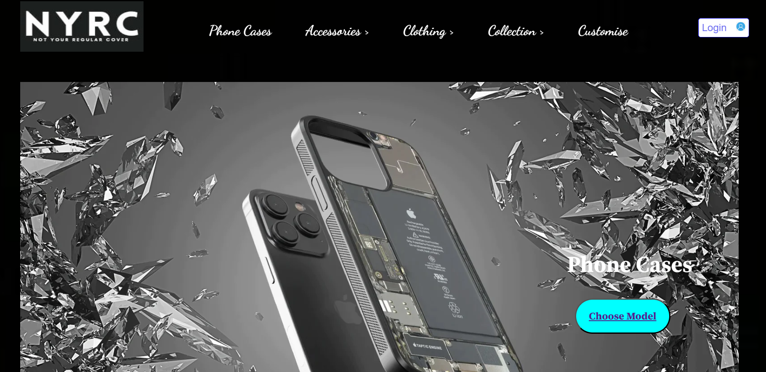
Source Code(Screenshorts)
As users navigate to our website, they are presented with an array of meticulously curated options, encompassing a diverse range of phone covers, desk mats, and hoodies, awaiting their discerning selection.
NYRC Cover Page
While clicking this option, you can choose your phone cover

Slide 16
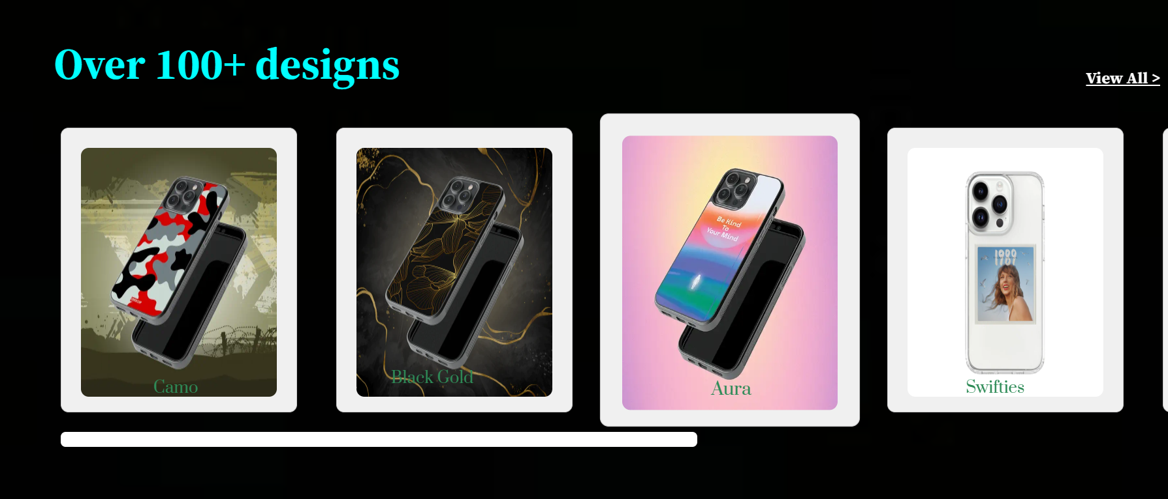
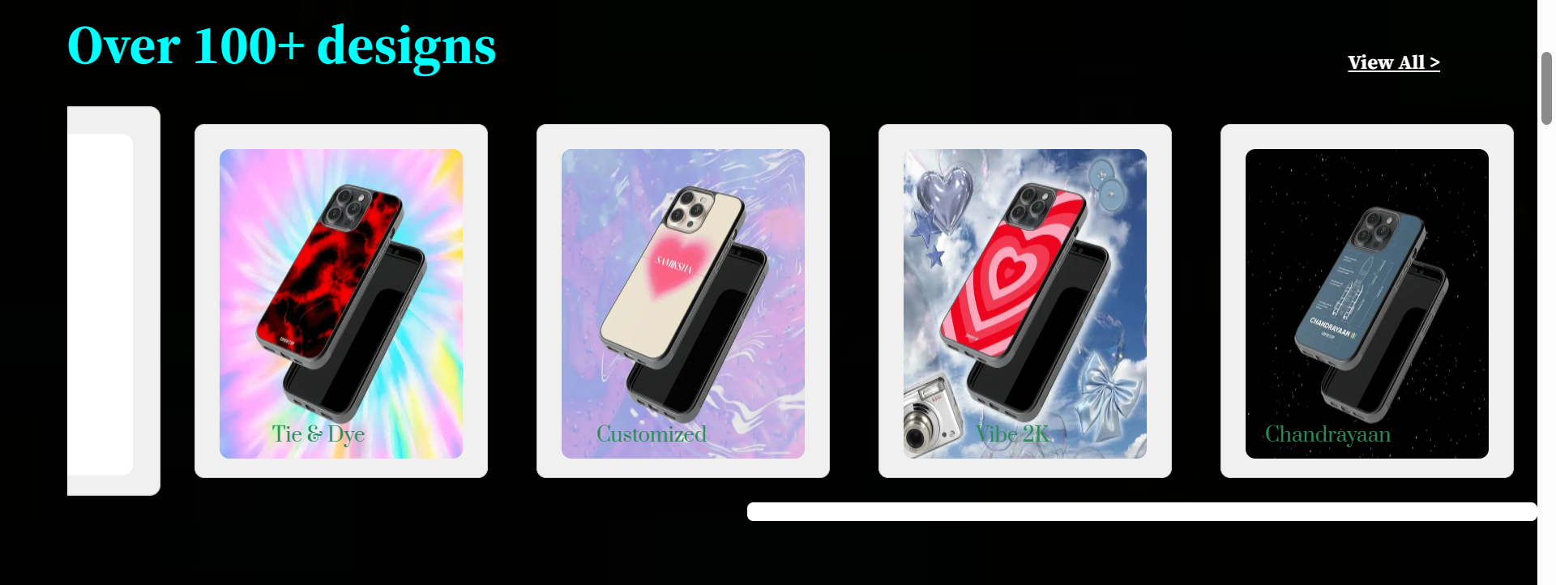
Contd.
As you slide, you get to see the options for phone covers which further on clicking gives you variety of options to select including a section for customization.

Slide 17
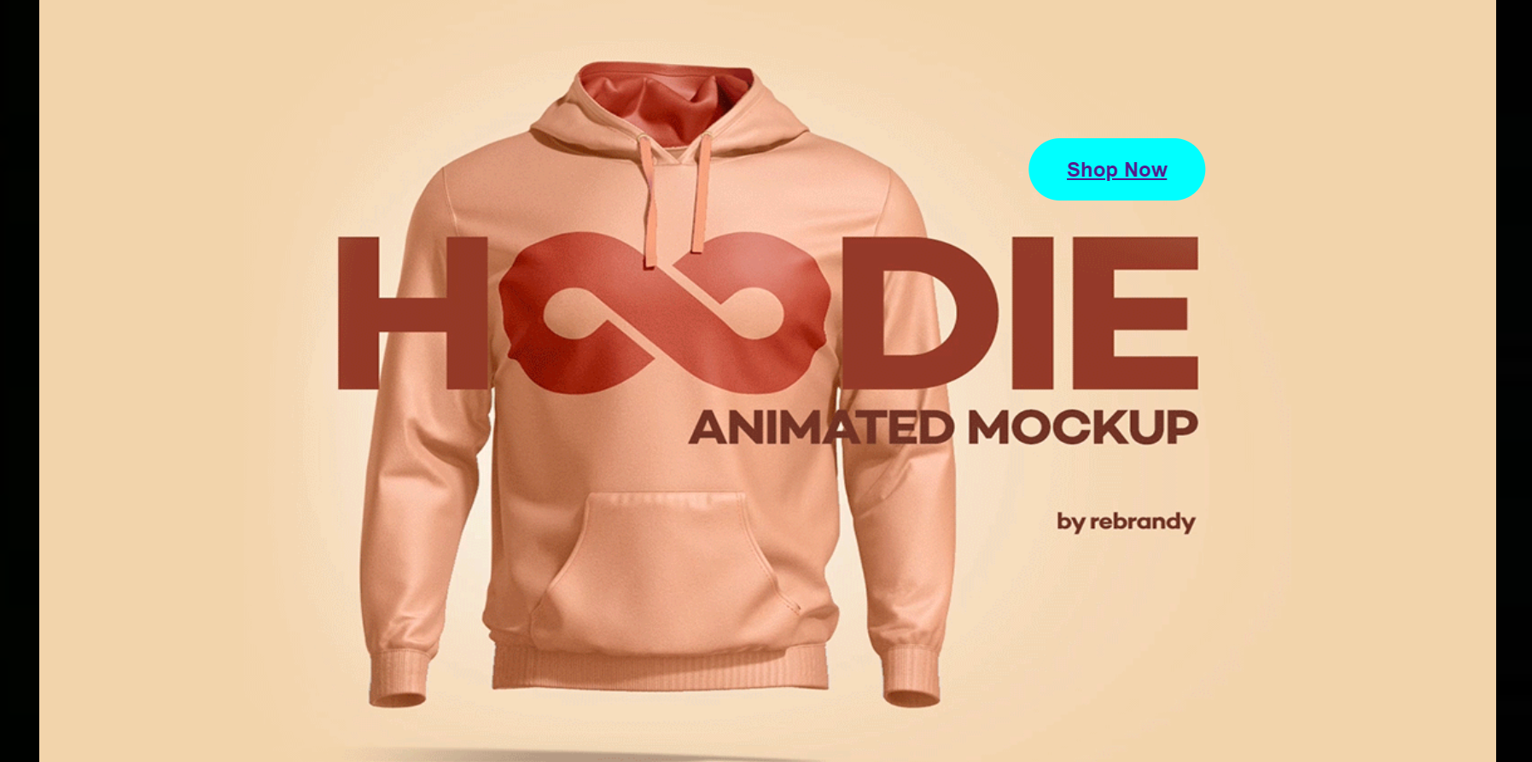
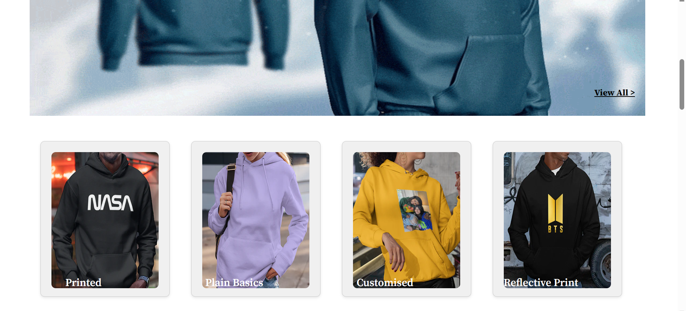
Contd.
On clicking Shop Now-you will get to see variety of NYRC Hoodie collection provided with a scrolling effect.
On clicking View All-our entire Hoodie variety will be presented
NYRC Hoodie
collection category

Slide 18
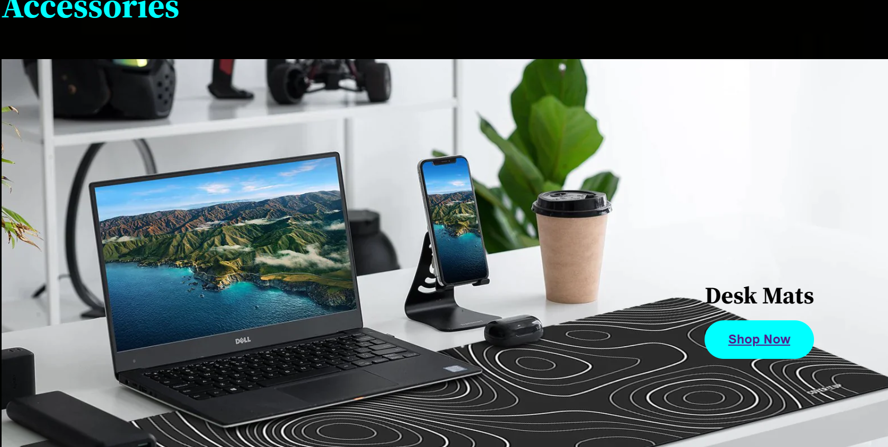
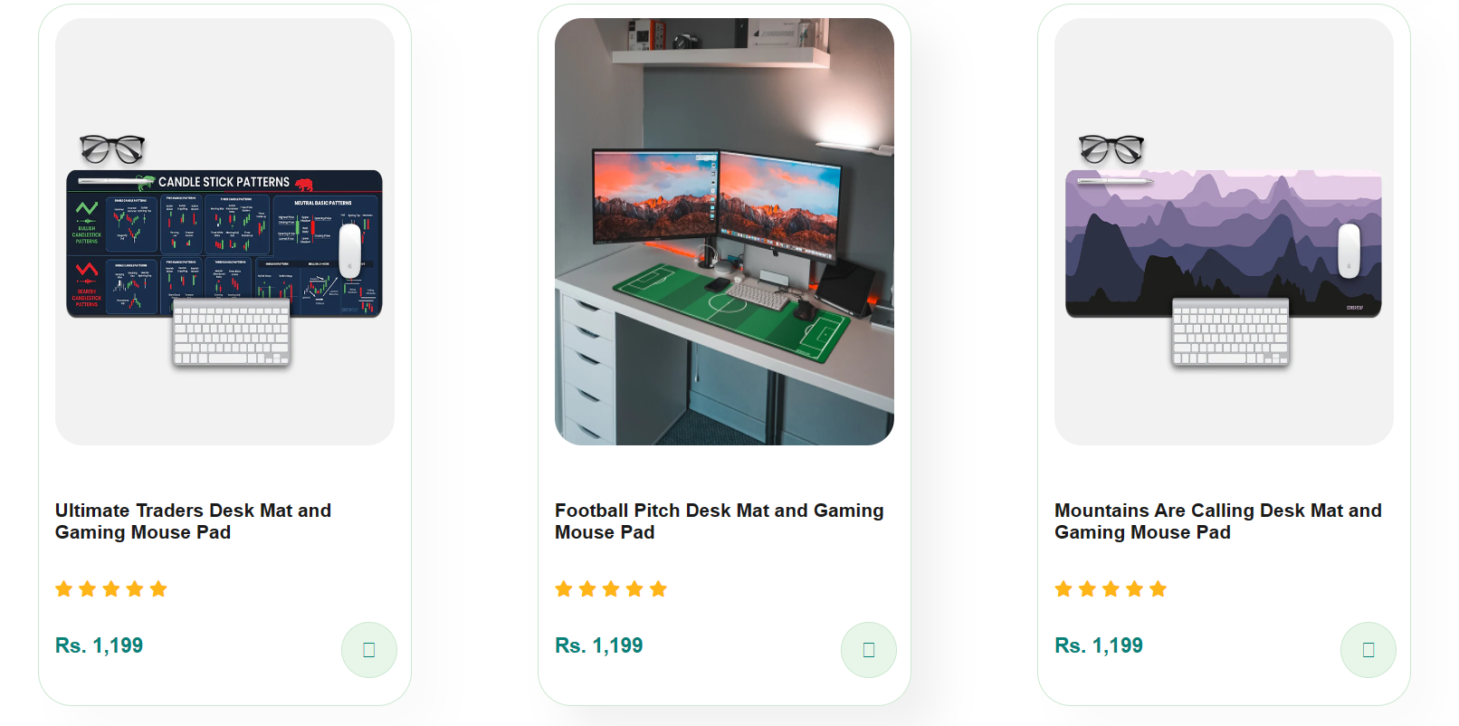
Contd.
On clicking Shop Now-you will witness variety of NYRC Desk Mats
Each desk mat option will showcase how it will look under keyboard, giving the buyer to understand the outlook of desk mats.

Slide 19

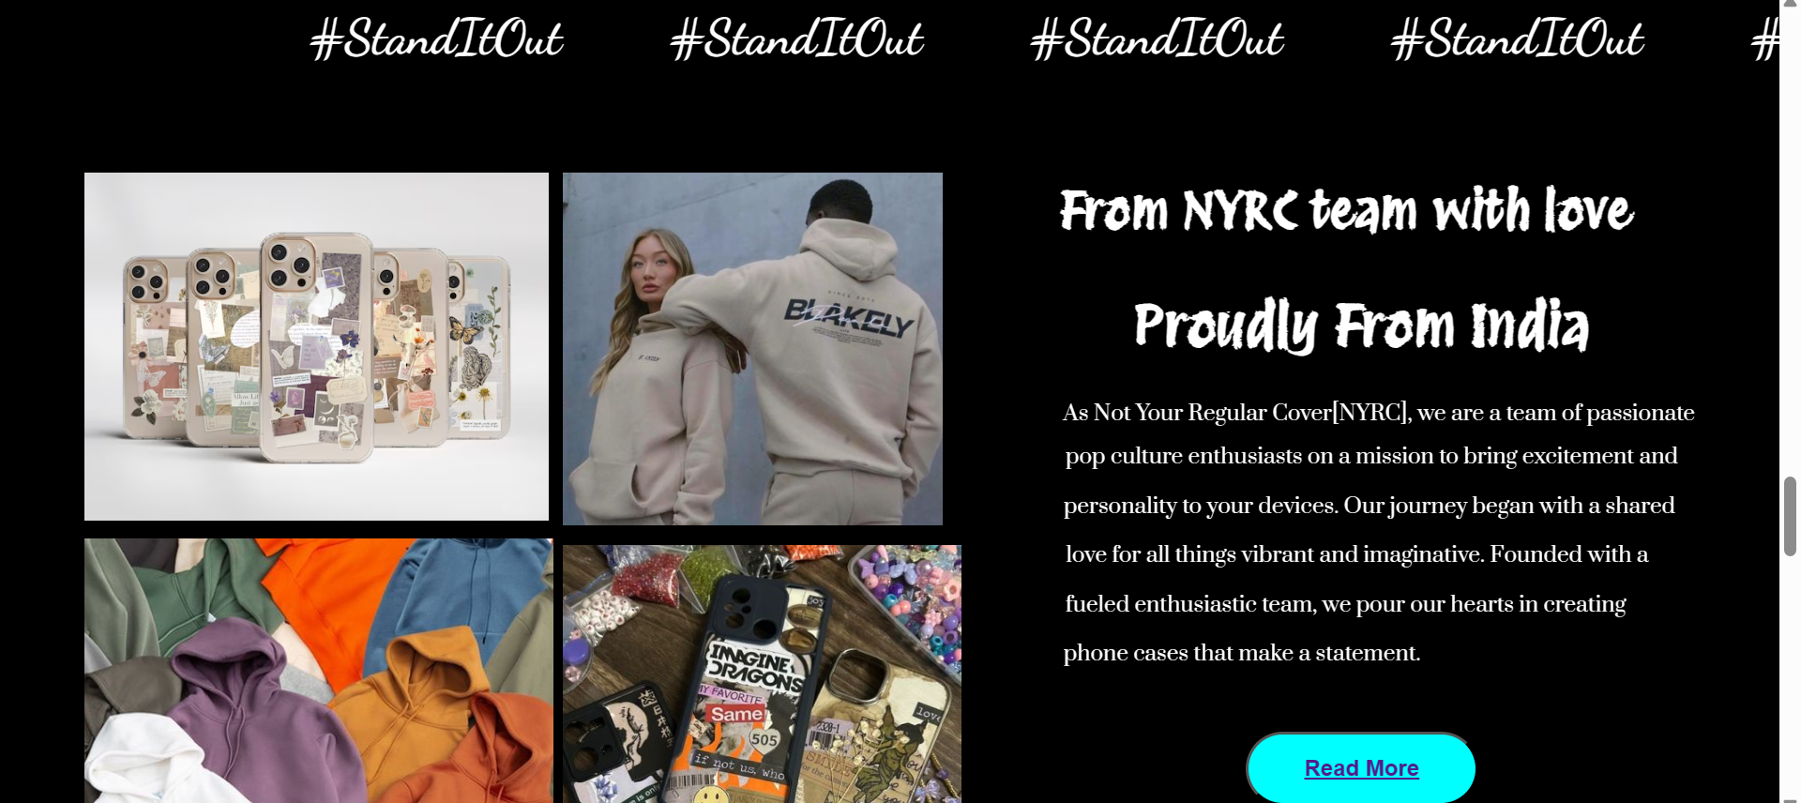
Contd.
NYRC Reviews by newspapers and magazines
This section is constantly moving making the website more engaging
On clicking this, buyer will get to know About Us of NYRC

Slide 20
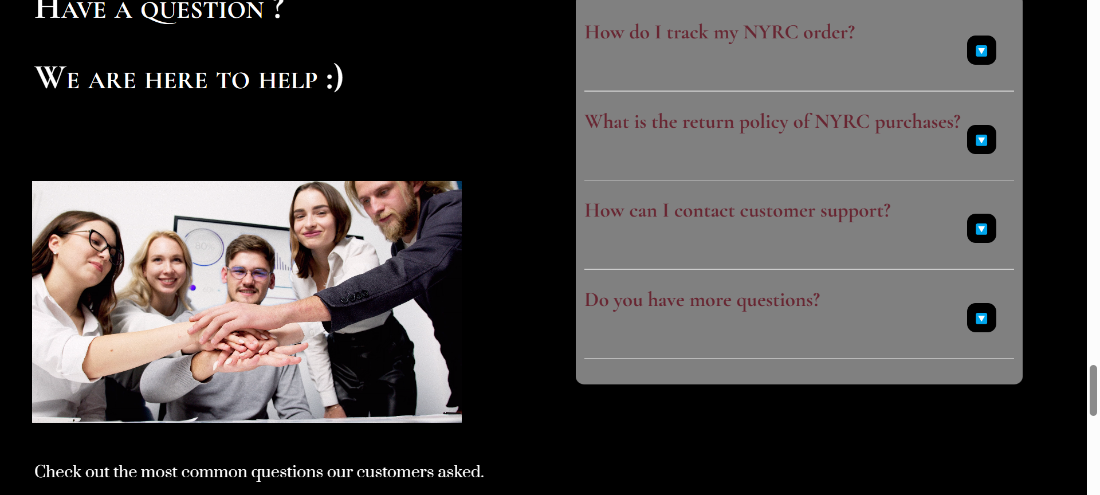
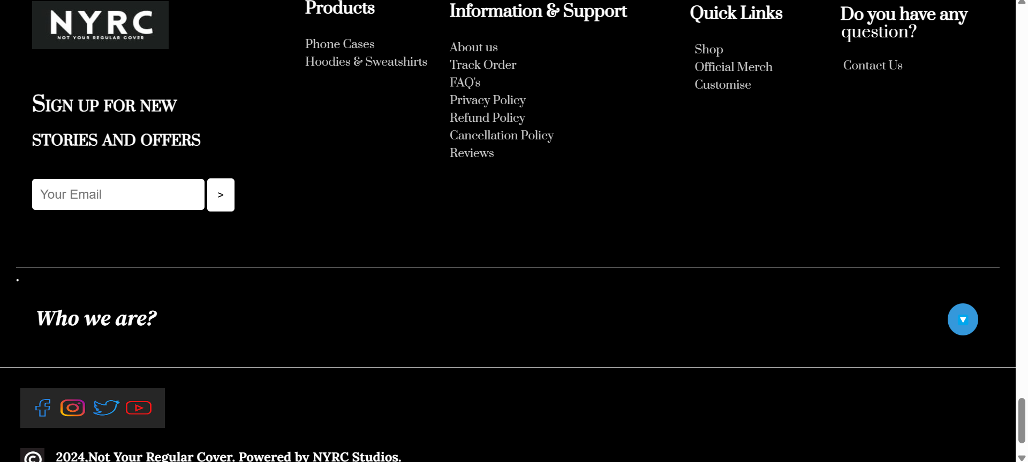
Contd.
This section provides answers to buyers. All the buttons are functional providing answers to respective questions.
This is the footer of the website.It provides the overview of NYRC giving buyer to sign up,shop,review,contact our team.All available options are working.

Slide 21
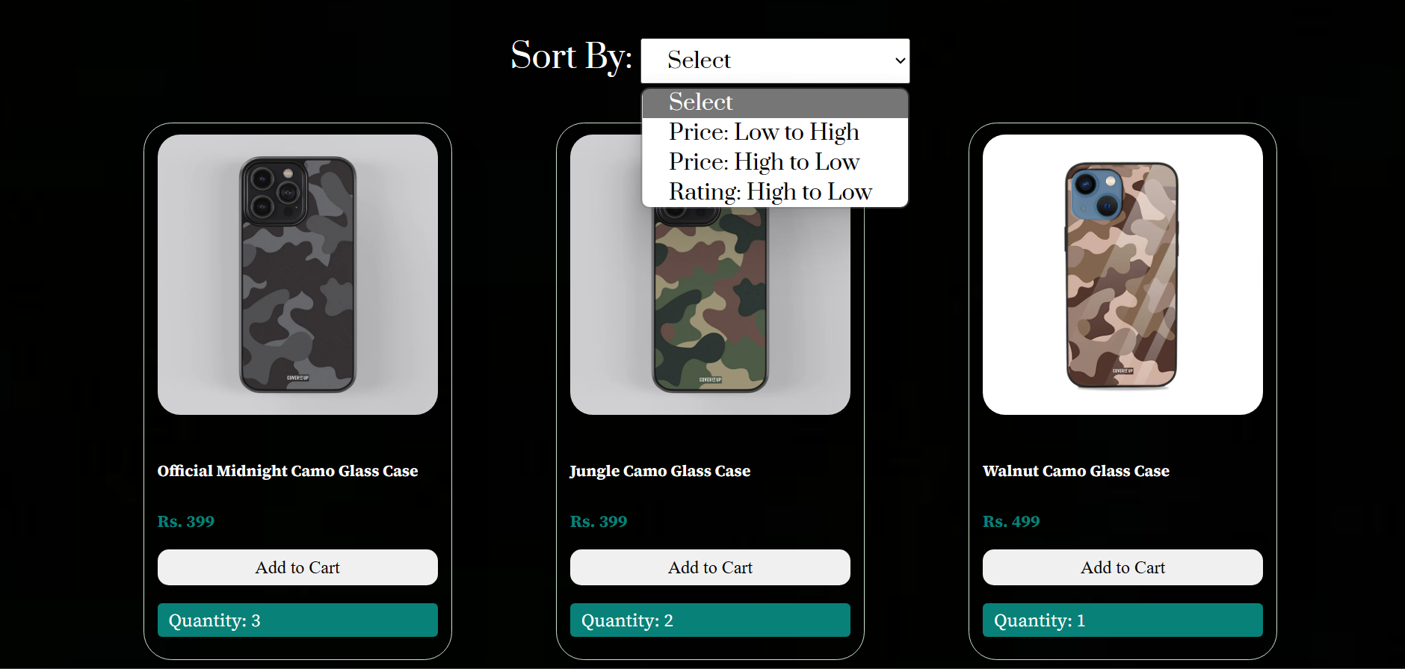
By clicking on SORT BY- it can be sorted on the basis of prices and rating.
By tapping on
ADD TO CART- quantity of the product will increase

Slide 22
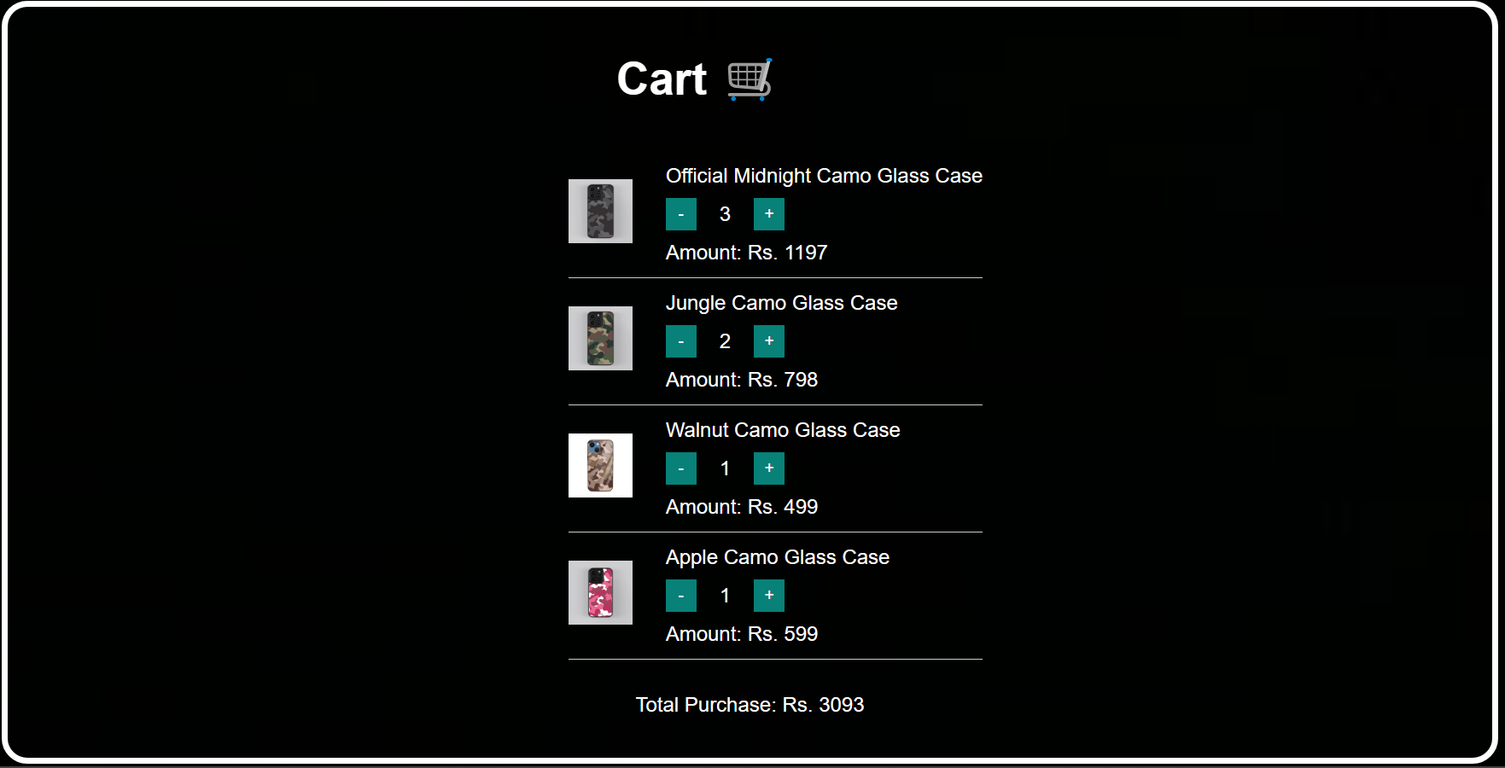
This is the FINAL CART.
In this total price, individual price of the product as well quantity of the selected products
can be adjusted.
QUANTITY ADJUSTMENT
INDIVIDUAL PRICE
TOTAL PRICE

Slide 23
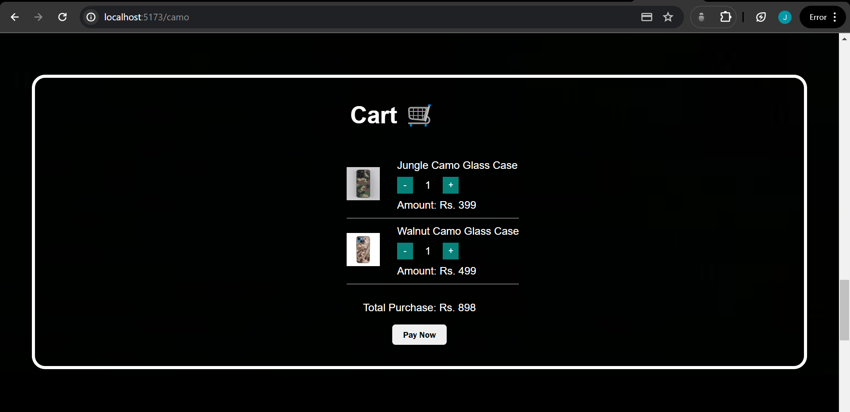
THIS PAGE HIGHLIGHTS THE PRURCHASES ADDED TO CART AND CONSUMER CAN PROCEED TO PAY

Slide 24
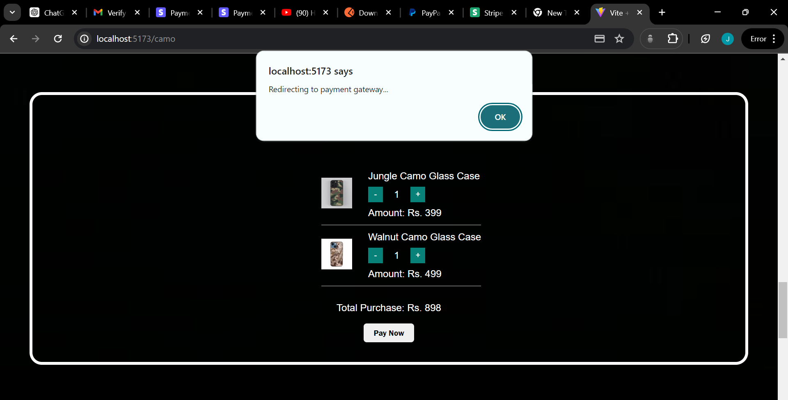
ONCE THE CONSUMER CLICKS ON PAY, HE/SHE IS REDIRECTED TO STRIPE PAGE WHERE HE/SHE CAN PROCEED TO DO THE PAYMENT

Slide 25
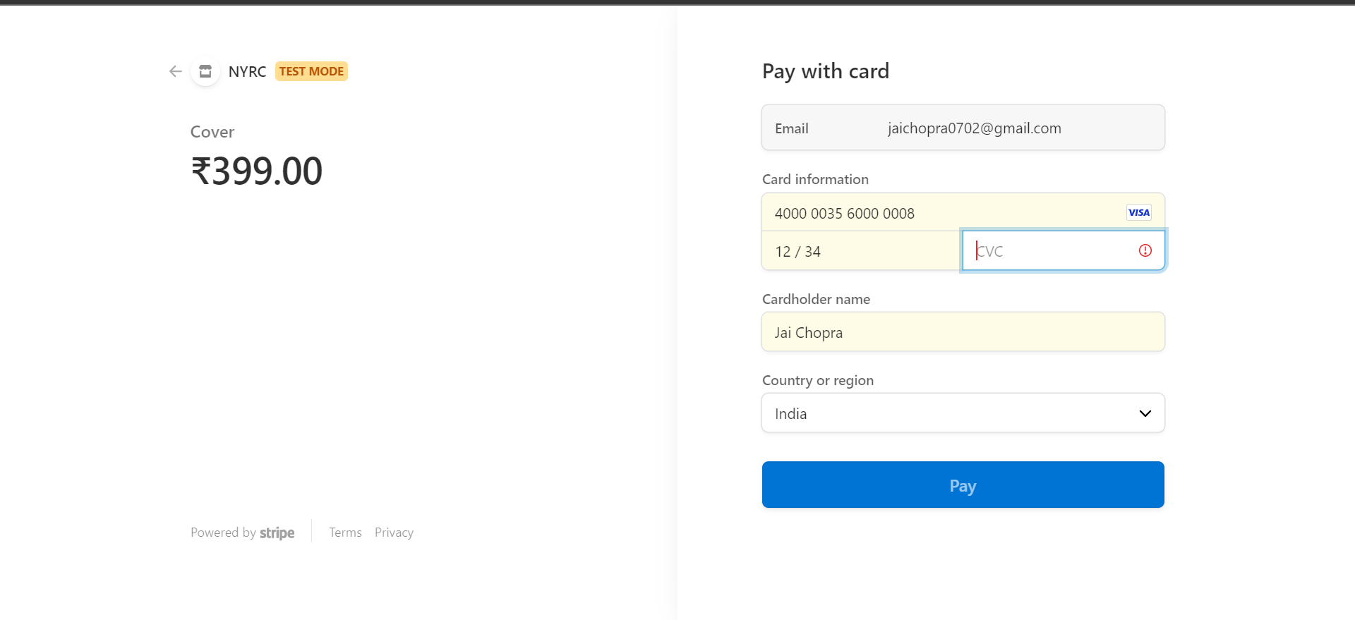
WHEN REDIRECTED, THE CONSUMER NEEDS TO ADD CREDENTIALS LIKE CARD DETAILS,CVV,COUNTRY NAME/REGION AND PROCEED FURTHER.

Slide 26
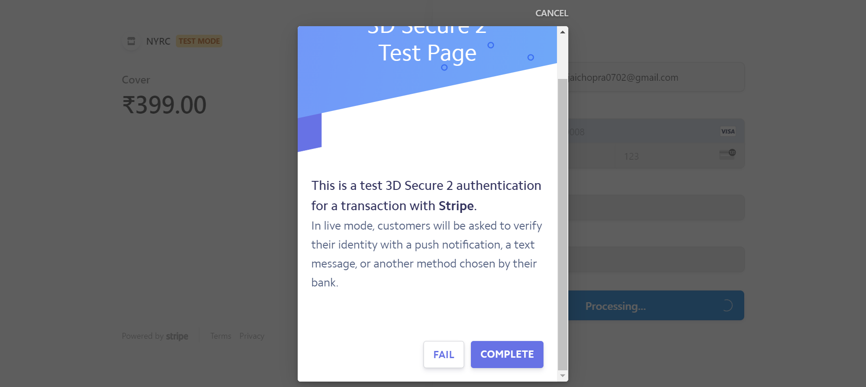
THIS IS THE FINAL CONFIRMATION REQUESTED TO CONSUMER WHETHER HE/SHE WISHES TO PROCEED THE PAYMENT.

Slide 27
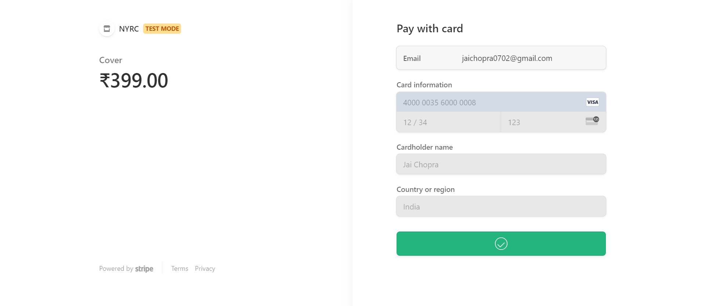
IN THIS THE GREEN COLOUR HIGHLIGHTS PAYMENT SUCCESSFUL.

Slide 28
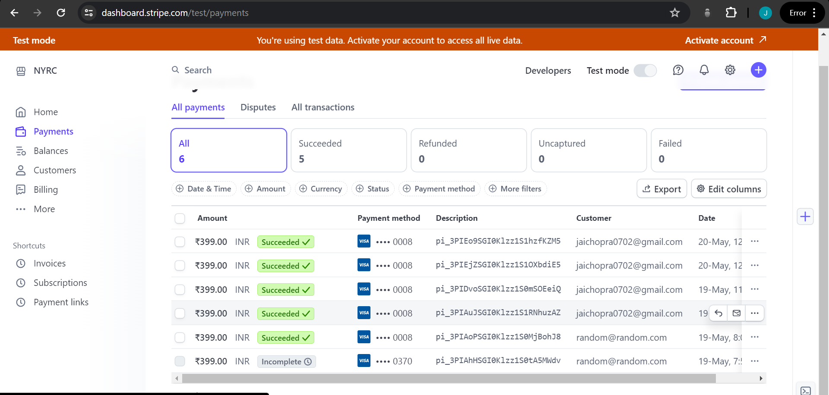
THIS HIGHLIGHTS WHETHER THE TRANSACTIONS ARE SUCCEEDED OR INCOMPLETE.THIS ALSO PROVIDES DETAILS OF THE INCURRED TRANSACTIONS.

Slide 29
Future Scope
Product Innovation: NYRC will remain at the forefront of product innovation, continually exploring new materials, technologies, and design concepts to enhance the functionality, durability, and aesthetic appeal of our offerings. From pioneering sustainable materials to integrating cutting-edge features, we will strive to exceed expectations and set new benchmarks for excellence in the industry.
Market Expansion: Building on our strong foundation, NYRC will explore opportunities for market expansion, both domestically and internationally. By identifying and tapping into new market segments and geographic regions, we aim to reach a wider audience and establish ourselves as a global leader in premium lifestyle accessories.

Slide 30
Contd.
E-commerce Enhancement: In an increasingly digital world, NYRC will prioritize the enhancement of our e-commerce platform to deliver a seamless and personalized shopping experience for our customers. From intuitive navigation to enhanced product customization options, we will leverage technology to create an immersive online retail environment that mirrors the luxury and sophistication of our brand.
Sustainability Initiatives: As stewards of the environment, NYRC is committed to sustainability and responsible business practices. In the future, we will intensify our efforts to reduce our environmental footprint, minimize waste, and source materials ethically and responsibly. By prioritizing sustainability, we aim to not only meet the expectations of our environmentally conscious customers but also contribute to a greener and more sustainable future.

Slide 31
Contd.
Community Engagement: NYRC recognizes the importance of fostering a strong and engaged community of customers, brand advocates, and industry partners. In the coming years, we will invest in initiatives that promote community engagement, including exclusive events, collaborative projects, and interactive online platforms. By fostering meaningful connections and dialogue, we aim to strengthen brand loyalty and affinity while staying attuned to the evolving needs and aspirations of our community.

Slide 32
Conclusion
At NYRC, we take immense pride in our carefully curated selection of premium phone covers, hoodies, and desk mats, meticulously crafted to harmonize style and utility seamlessly into your daily routines. Our products epitomize the essence of durability, functionality, and aesthetic sophistication, ensuring each item becomes an indispensable part of your lifestyle, while also making a bold statement of individuality.
Our commitment to excellence is evident in the unparalleled craftsmanship, ensuring your devices are safeguarded with the utmost care and attention to detail. Our fashion-forward apparel is designed to not only elevate your personal style but also reflect the latest trends in the industry. Additionally, our sophisticated accessories are meticulously tailored to enhance your workspace, adding a touch of elegance and professionalism to your surroundings.

Slide 33
Contd.
Embark on a journey of discovery as you immerse yourself in the fusion of quality, elegance, and affordability, available exclusively at NYRC. Explore our meticulously curated collection today and elevate both your personal and professional spaces with unparalleled distinction.

Slide 34
Reference
Cover It Up- https://coveritup.com/
Case Factory- https://thecasefactory.in/
Souled Store- https://www.thesouledstore.com/men
Pinterest- https://in.pinterest.com/
Red Wolf- https://www.redwolf.in/

Slide 35
The End

